Slide 1
Feasibility of Using Large Language Models for Requirement-Based Software Testing
Alexander Seyr

Slide 2
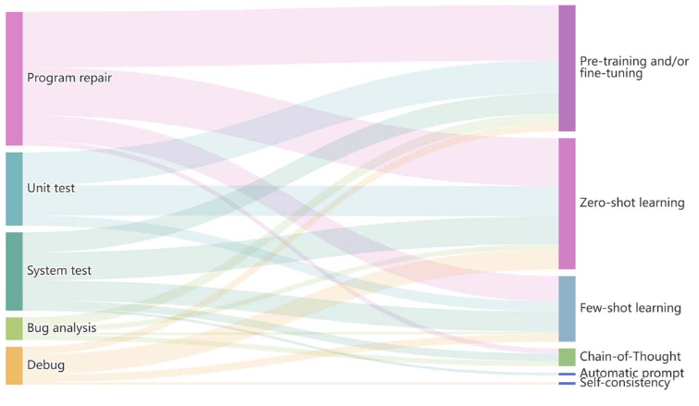
Software testing overview
Quality assurance through testing
In practive a lot of manual labor
Strategies
Unit testing
Integration testing
Acceptance/Validation testing
System testing
Mapping between testing tasks and how LLMs are used
Wang, Junjie / Huang, Yuchao / Chen, Chunyang / Liu, Zhe / Wang, Song / Wang, Qing, Software testing with large language models: Survey, landscape, and vision 2024 IEEE Transactions on Software Engineering
Anwar, Nahid / Kar, Susmita, Review paper on various software testing techniques &amp; strategies, 2019, Global Journal of Computer Science and Technology , Vol. 19, No. 2 p. 43-49
Notes:
As we all know we need software tests to ensure a certain quality of the applicaton.
Now to which extend testing is done is dependent mostly on
the domain (how much security, contraints, …)
and availability of resources (human resource, financal).
-> trade off between under and over testing and cost
In practice a lot of manual work in many situations repetitive and at some point lets be honest boring.
As many tests are quite simple.
Even tho not as bad as writing documentation.
I think that’s one of the main reasons why this is such an interesting application for LLM’s. (engineers lazy / boring work -> lets automate)
LLM with their inreasing capabilities open up possibilities to change the classic approach and potentially minimize or optimize the testing procedure.
Unit testing: smallest testable part (done by developer)
LLM already very capable much research - automating unit test generation for high coverage
From my experience not yet established very well in the industry
Integration testing: integrate unit tested component and test them as a group – interfacing
Research??
Acceptance/Validation testing: authenticate whether product is developed as per standards and detailed criteria and meets all requirements specified by the user
ReSystem testing: testing done on complete integrated system
search??
Many LLM applications-> software already done for the most part. (mainly for GUI testing mobile apps)
Generating test scenarios for the whole system
Even projects which act as a whole development team (archcode) -> given problem statement and system goes through the whole process of
Defining requirements, creating testcases and implementation.

Slide 3
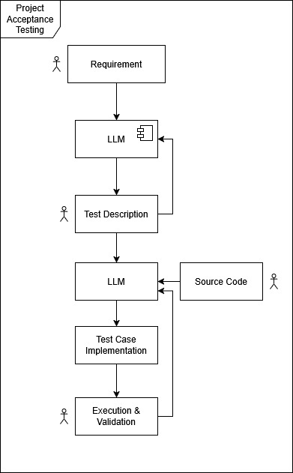
Focus of this study – Acceptance Testing
Are requirements fullfilled?
How capable are LLM’s in:
Understanding requirements in technical domain?
Deriving test descriptions from requirements?
Is there potential for automation?
Notes:
What I am interested in and where I also found little research is trying to utilize the software requirements as a resource to generate testcases.
As in industrial settings integrating LLM’s in the development processes will be a step by step process.
Since for unit testing they are already commonly used, I wanted to approach the topic from the other direction starting at the requirements.
acceptance testing
High confidence that requirements are met is required at an early stage of developement.
I am interested in how capable LLM’s are in generating structured test case description out of natural language requirements.
Especially in techincal domains.
Vision that in the future the approach would be a semi automatic acceptance testing pipeline with human in the loop.
requirements -> LLM -> TC’s + Human verification as a first part of the pipeline
-> LLM -> implementation human or machine + verification through gernerated TC + Human verification
First we need to get an impression of how capable the models are to understand the requirements.

Slide 4
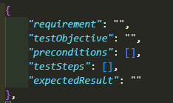
Experimental Setup
Evaluation Procedure
Use prompt engineering techniques to generate testcases
Basic Test Description structure shall be enforced
Validation framework for quality estimate of Model + prompt variations
Simple structural checks
SpaCy for field characteristics
Human verification as final evaluation
Notes:
As an experimental setup I first thought about the evaluation procedure.
As the difficulty should not be to generate output, but to evaluate the quality of the output
Therefore I created a framework for structured test descriptions.
General structure shall be enforced using JSON which is a common way to get structured output from a LLM -> this already introduces a kind of directional stimulus.
Requirement, test objective, preconditions, test steps, expected result
Using prompt engineering techniques to generate testcase for each requirement.
Implement validation structure for each component of the test description for a first quality estimate of model and prompt.
Requirement -> high cosine similarity with original
testObjective -> describes the goal shall start with a verb
preconditions -> describes a state
testSteps -> generic check for list of sentences
Expected results ->
As a last step human verification.

Slide 5
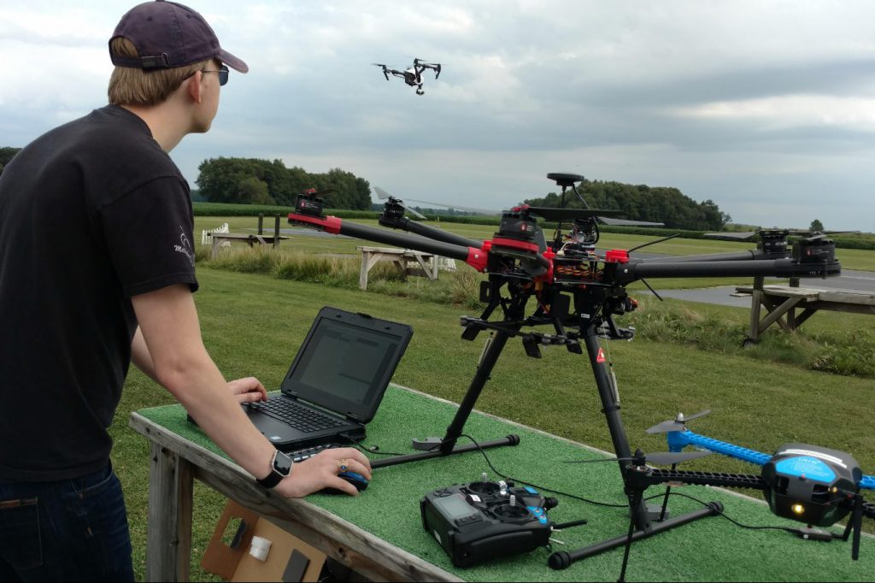
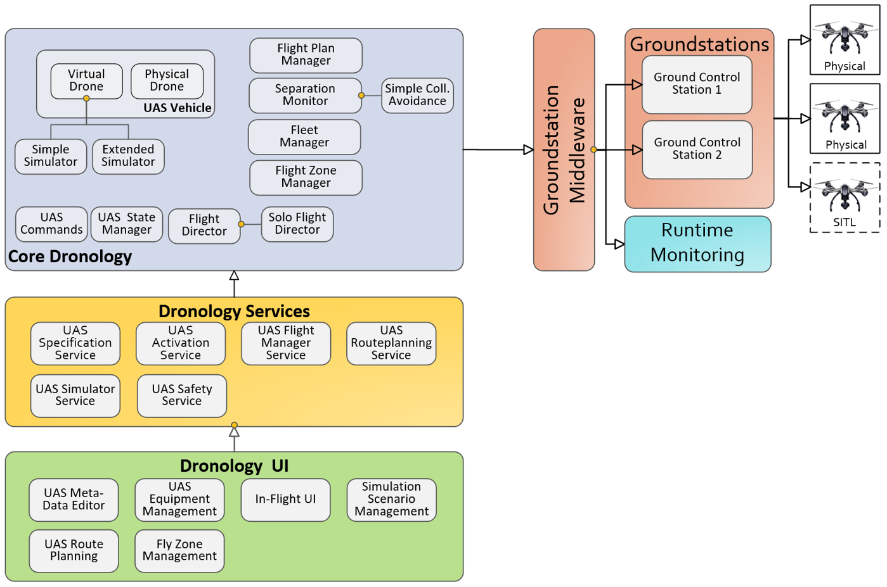
Experimental Setup
Evaluation on Dronology
Unmanned Aerial Systems Management and Control
research environment
framework for controlling and coordinating the flight
https://dronology.info/
Notes:
I also want to quickly talk about the domain
Dronology is an Open-Source Unmanned Aerial System (UAS) developed at the University of Notre Dame.
Two goals:
establish a research environment for studying various aspects of software and systems engineering for cyber-physical systems -> that’s why requirements public
to provide a framework for controlling and coordinating the flight of individual UAS, formations, and swarms in order to to support applications such as search-and-rescue, surveillance, and scientific data collection.
It is designed around the concept of a Dronology Core
Services middleware that support UI development
Groundstation middleware that supports communication with diverse UAS.
Dronology Core provides features for coordinating the flights of multiple sUAS in a shared airspace.
Dronology services are used by various clients to construct user interfaces.
The services can be used to perform tasks such as upload flight plans, activate UASs, observe and visualize UAS flights, and register equipment to individual UAS.
The ground station middleware provides a bridge between the Dronology core and a diverse set of ground stations.
It passes directives from the Dronology core to UAVs registered through their respective ground stations, and forwards UAV data, such as their GPS coordinates from the ground station back to the the core. Groundstations are responsible for communicating directly with the physical or externally simulated UAVs.

Slide 6
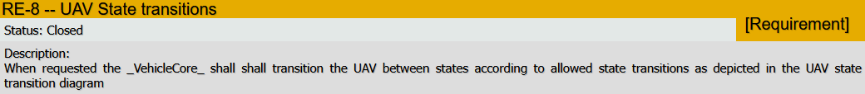
Experimental Setup
97 Requirements
Short and precise
Notes:
Total of 97 requirements
Examples shown, always a trade off of how much time and effort you put into the requirements.
Requirements engineering its own topic
Biggest factor therefore are definitions of requirements
how detailed requirements are defined – usually using natural language
room for interpretation – possible conflicts, … but definition is another topic (verifying requirements for completeness, integrity, …. Is another story)
requirements define what the system must to but not how.
basic functionality of a system shall be tested through simple testcases that relate to at least one requirement.
(Website says source code will be available in the future)

Slide 7
Prompt Engineering techniques
Zero shot learning + Directional stimulus
Personas – software tester
Tree of thought – multiple experts
Providing Context
Dronology introduction + TOT
Preparsing of requirements + TOT
Baseline
Notes:
Shortly discuss the prompt engineering techniques I focused on.
As a baseline Zero shot learning was used with directional stimulus
Json test description structure can be seen as providing directional stimulus
Personas – software tester + json structure
TOT – multiple experts discussing solution if one is wrong he steps back + json structure
Providing context
First in form of introduction of dronology design
Preparsing all requirements + TOT

Slide 8
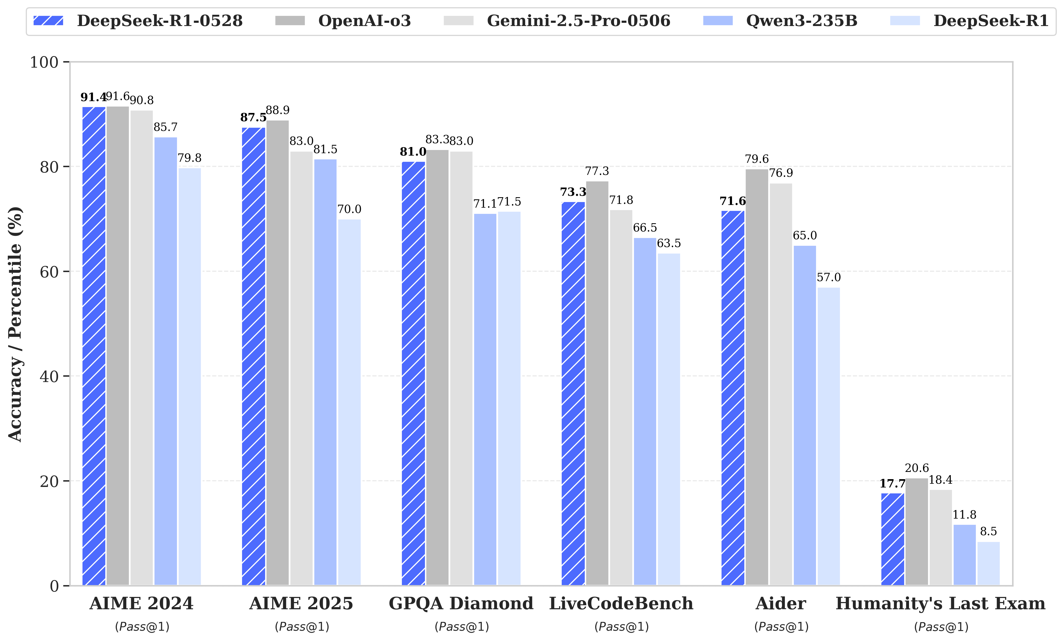
Models - Deepseek-r1
Distilled
1.5b
7b
8b
14b
32b
…
Ollama 0.6.2
local
independent
Fixed Parameters
Notes:
Deepseek made quite the news when it was published.
and has also shown that reasoning patterns of large models can be distilled into smaller ones.
Smaller perform better if learning from bigger than learning on their own (through RL)
This allows to run LLM’s locally with limited resources and fully independent.
Which is usually required when when developing software as most of the time we don’t want the requirements to be public.
Therefore I wanted to see whats possible with distilled models.
To make the results comparable I used a fixed set of model parameters across distilled versions.

Slide 9
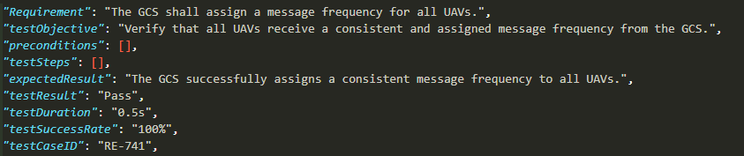
Results
Example 1.5b zero shot
Output generation
Unstable output with default parameters
1.5b – very unreliable
32b parameters - local resource limit
Present tense check – systematic fails
Requirement format:
“When given situation / state … shall react in certain way.”
Likely result in a last test step:
“Verify that the selected map layer is displayed correctly.”
-> Not catched by defined rule
Notes:
ID is added manually – lack ability of kepping exact count
Ollama added AMD support march 2024 but first did not check -> 8B PC slow down -> mine is too old (Rx 6600)
All done with CPU AMD Ryzen 5 5600x 6-core and 32 GB of RAM.
14b -> CPU and Memory full PC unusable
Increased context window (Sets the size of the context window used to generate the next token. (Default: 2048))
Decreased repeat penalty (Sets how strongly to penalize repetitions. A higher value (e.g., 1.5) will penalize repetitions more strongly, while a lower value (e.g., 0.9) will be more lenient. (Default: 1.1))
Decreased top_p (Works together with top-k. A higher value (e.g., 0.95) will lead to more diverse text, while a lower value (e.g., 0.5) will generate more focused and conservative text. (Default: 0.9)
I expected the present tense check to not be perfect.
Systematic fails were caused.
Two main contributors.
First when a requirement is formulated like…
Second models also sometimes like to end the test steps with ….
Verify that ….
Verify that the selected map layer is displayed correctly. -> Imperative sentence with present tense (passive voice).
not catched by rule
Could also argue to use LLM for present tense classification, but I wanted to have little bit of control.

Slide 10
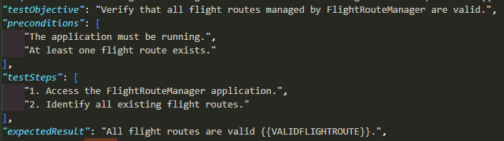
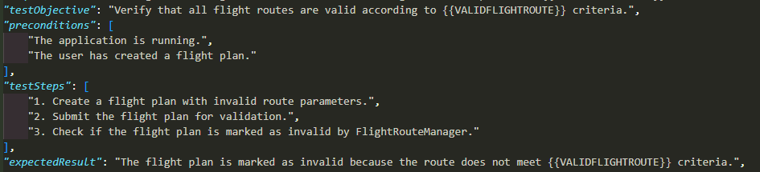
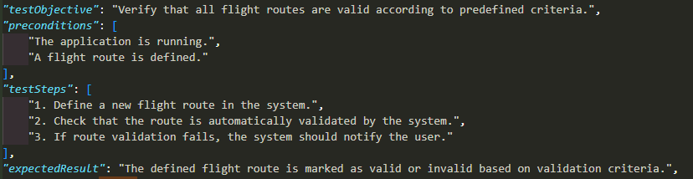
"The FlightRouteManager shall ensure that all flight routes represent a {{VALIDFLIGHTROUTE}}.“ (RE-503)
 | Model Size
Prompt | 1.5 | 7 | 8 | 14
Zero | invalid json | empty | empty | empty
Persona | timeout | empty | ok | good
TOT | empty | empty | ok | empty
Context + TOT | empty | empty | ok | empty
Preparsing + TOT | timeout | empty | ok | best
TOT 8b
Context + TOT 8b
Preparse + TOT 8b

Slide 11
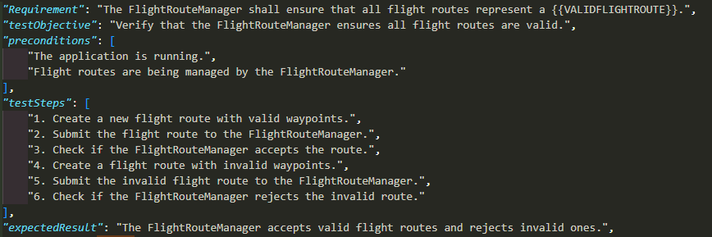
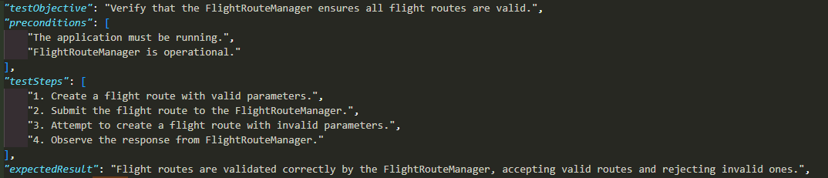
RE-503 continued
Preparse + TOT 14b
Persona 14b
Notes:
RE-503

Slide 12
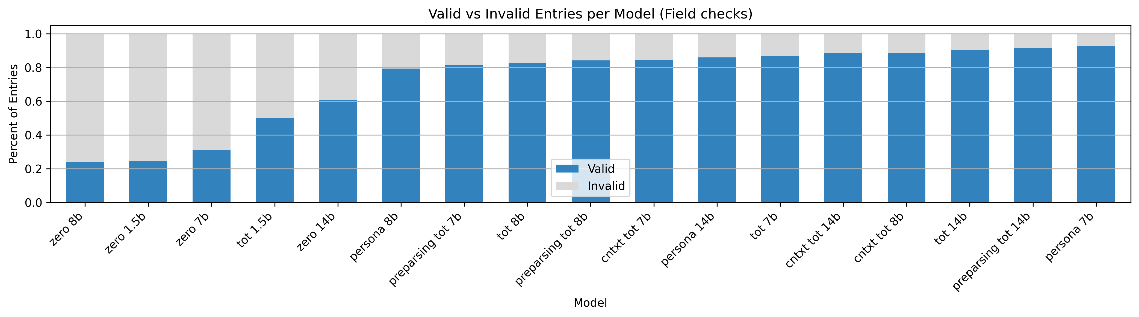
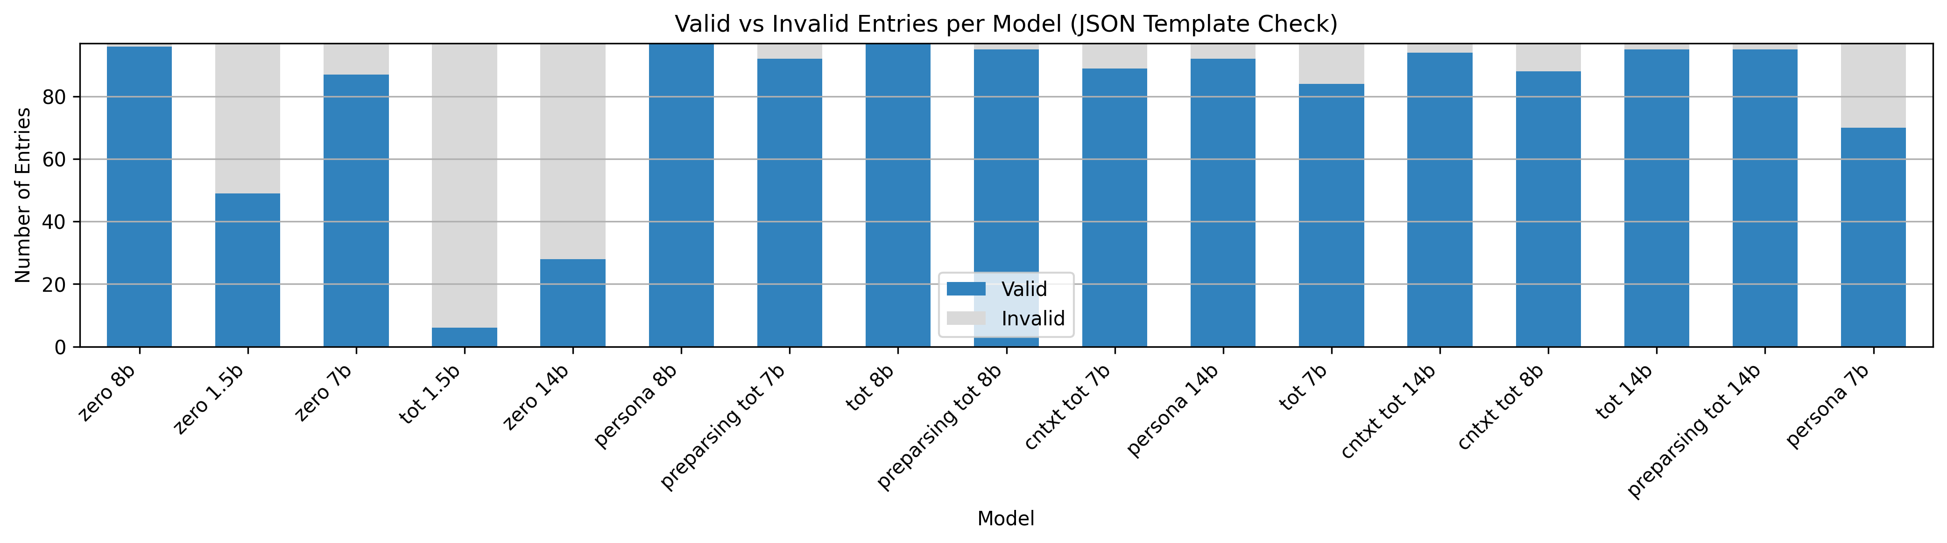
Results
Notes:
Upper bar chart shows percentage of valid entries per model and prompt variation – sorted from worse to best
So including all field checks, if any single field check fails it is counted as an invalid entry.
Lower bar chart shows number of valid entries per model and prompt variation
Only from a json template point of view. Valid entry here means the model was able to generate the expected json template.
Trend that Json entry validity increases with model size.
But field quality from rules already good for 7/8 b models, although the actual coverage of the test description is likely to be still better with bigger model.

Slide 13
Results
95 #
90 %
95 #
92 %
Notes:
To conclude …..

Slide 14

Q & A

